Slide 1

Energy calibration of a 2.5MV Pelletron

Slide 2
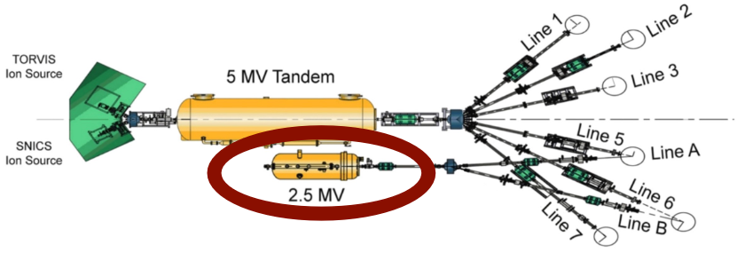
Energy calibration of the 2.5MV pelletron
Yield measurement of resonance strengths in 27Al(p,γ)28Si due to the well-documented reaction process
Proton beam onto a 27Al target and a NaI γ -ray detector

Slide 3
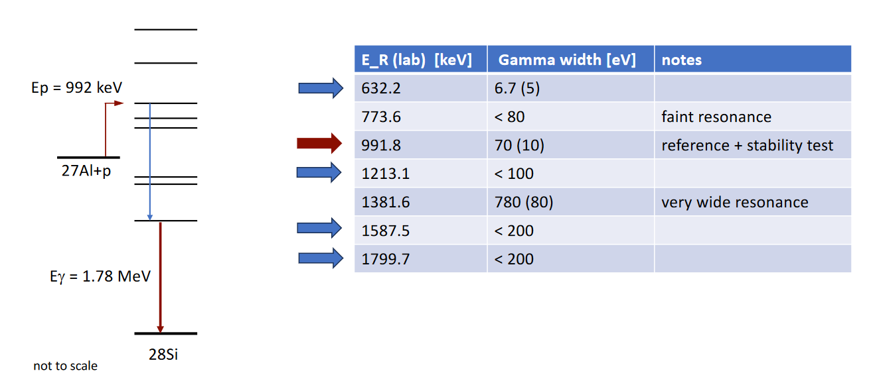
Resonances in 27Al(p, γ)28Si

Slide 4
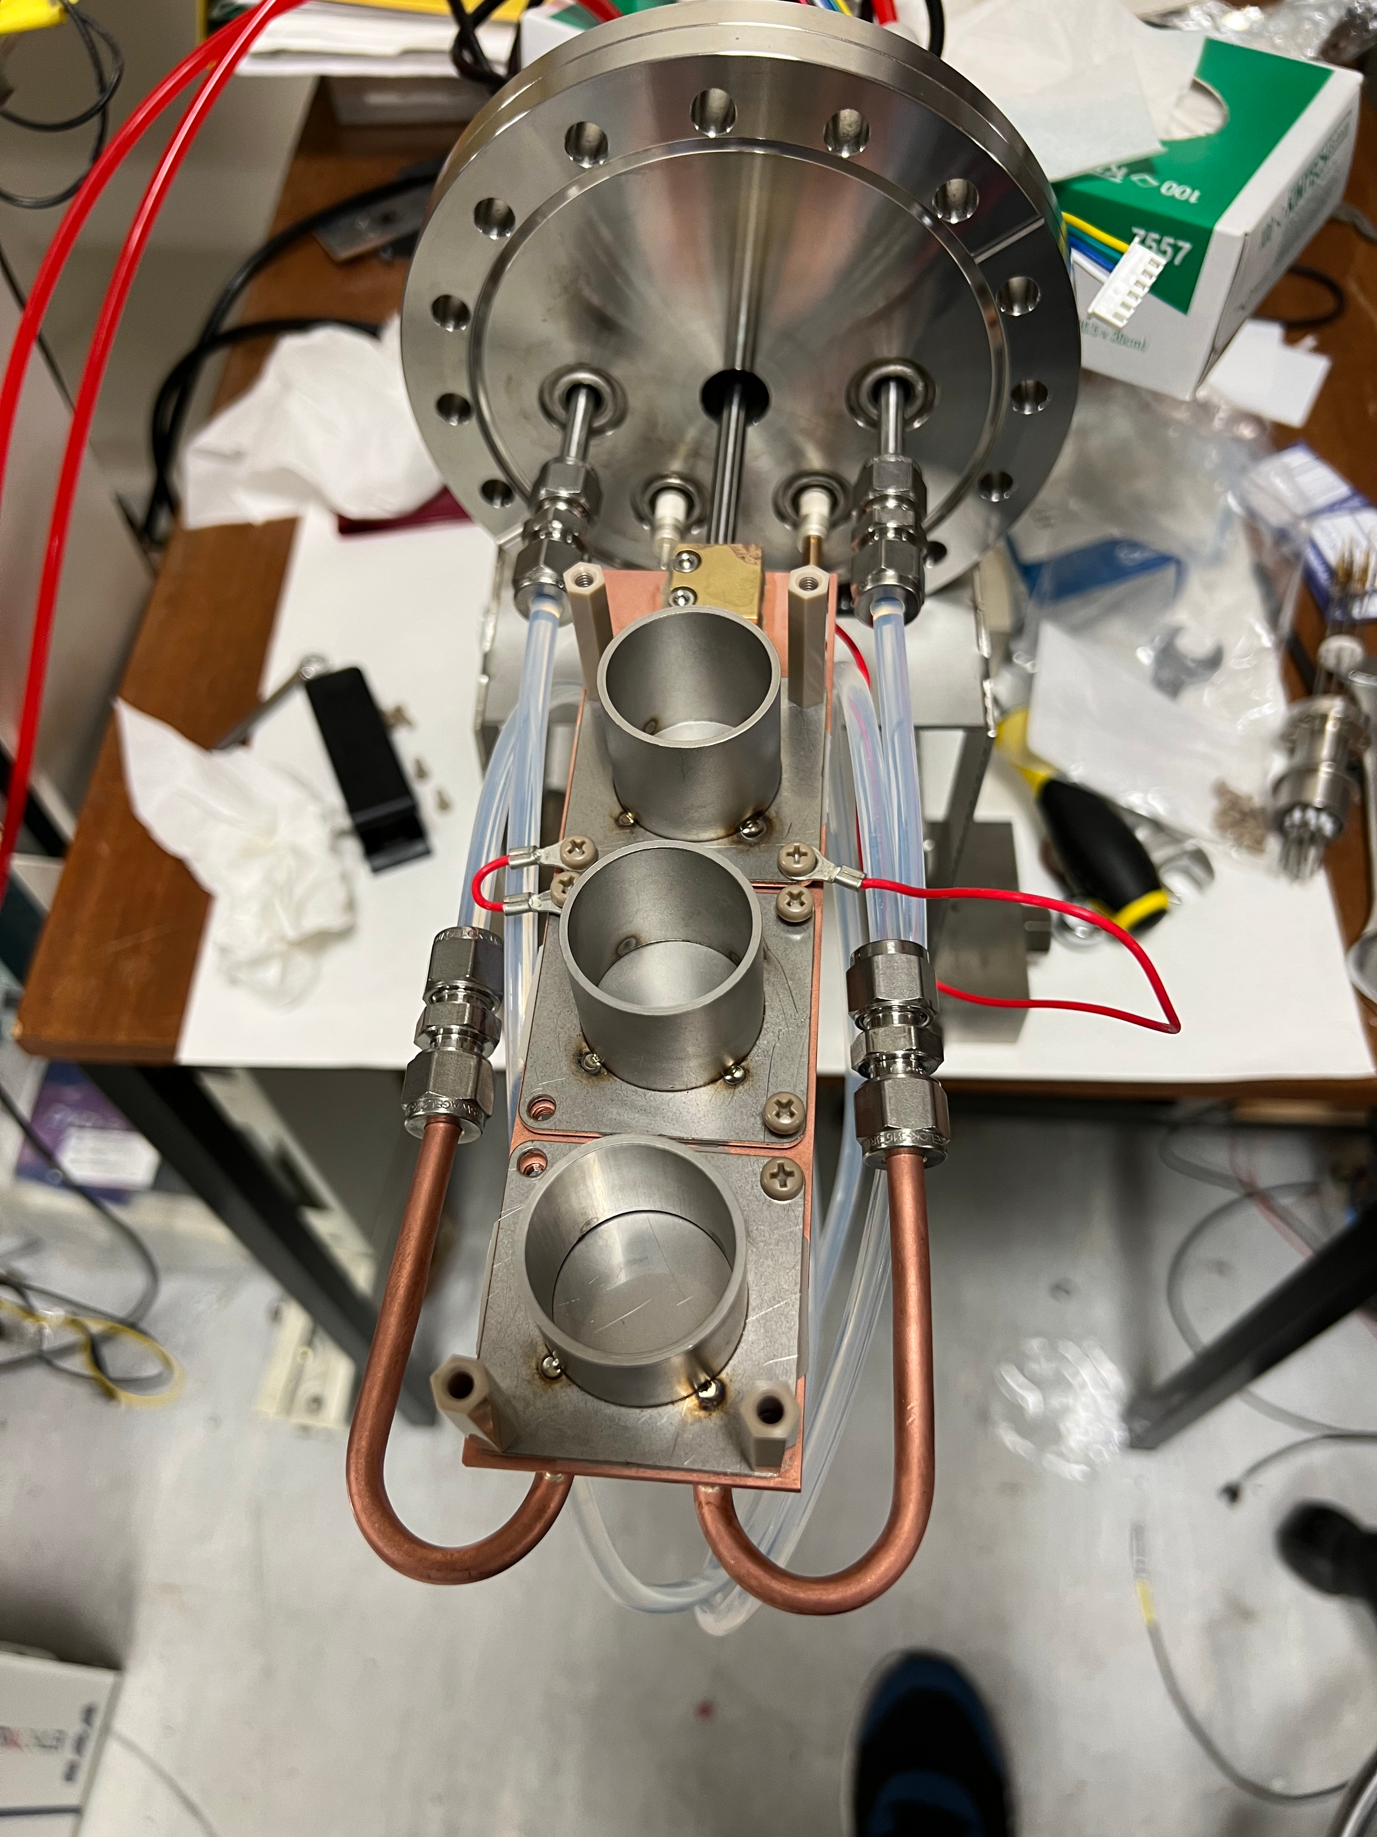
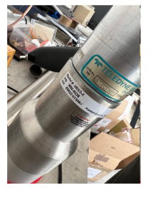
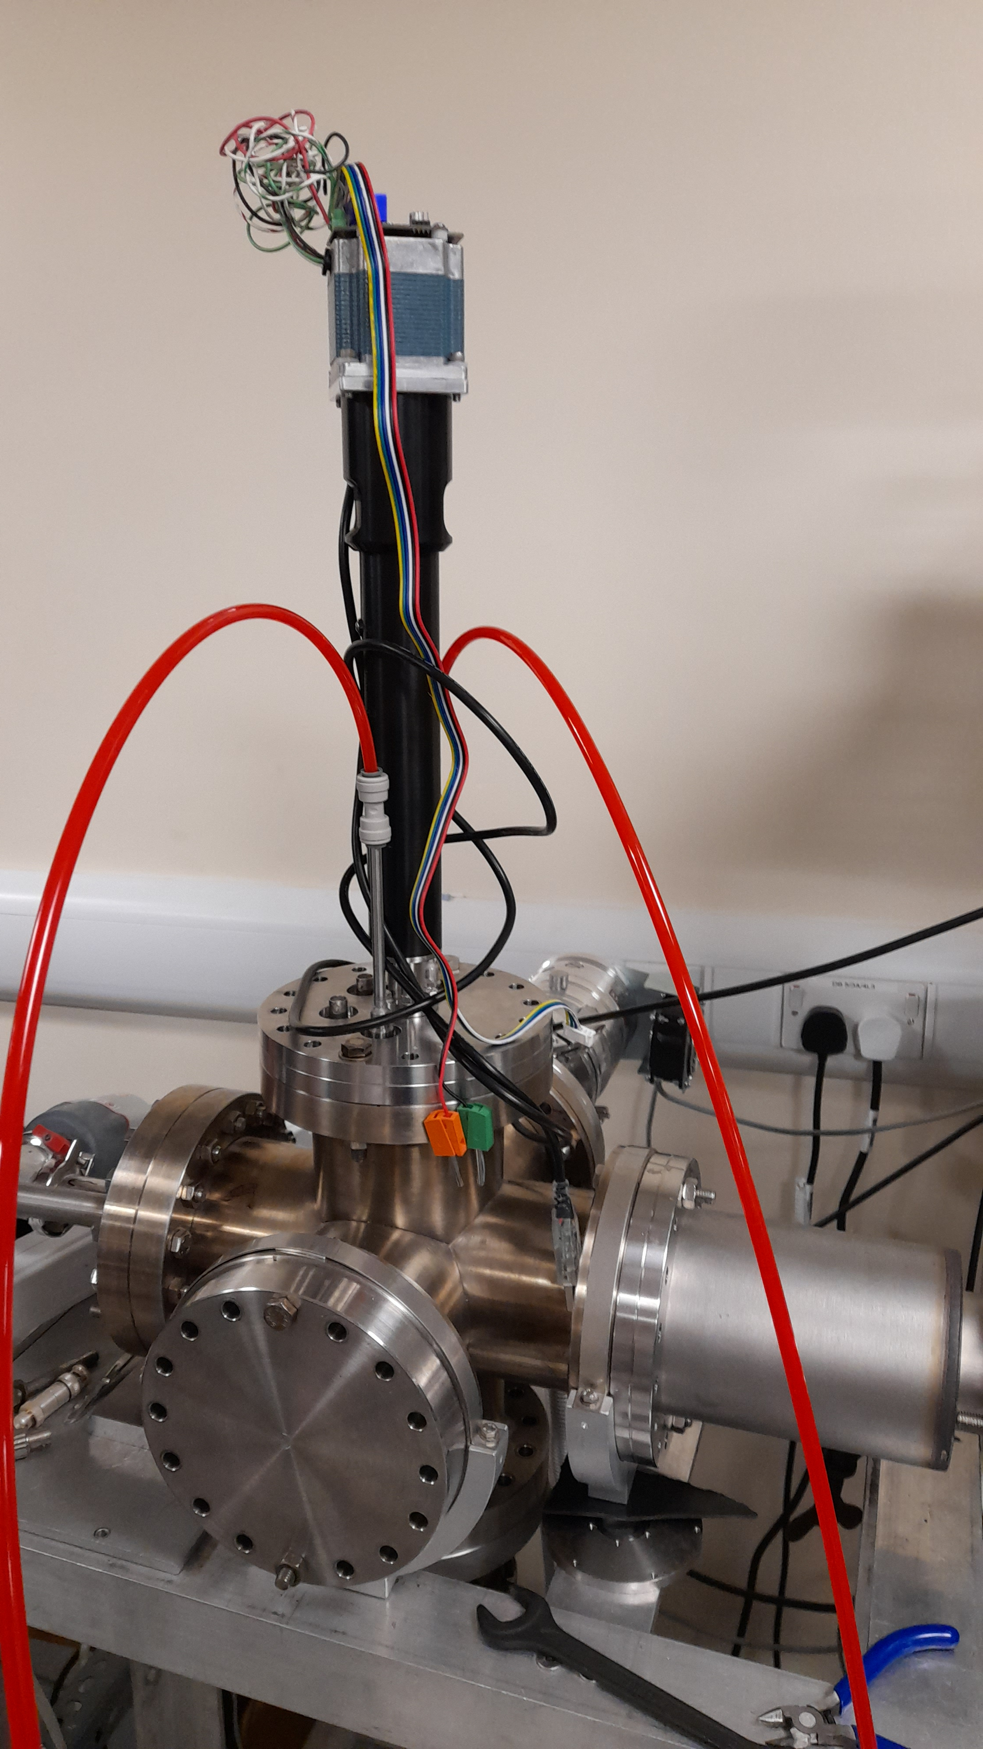
Experimental set up
Aluminium target
Water cooling
Actuator
NaI detector

Slide 5
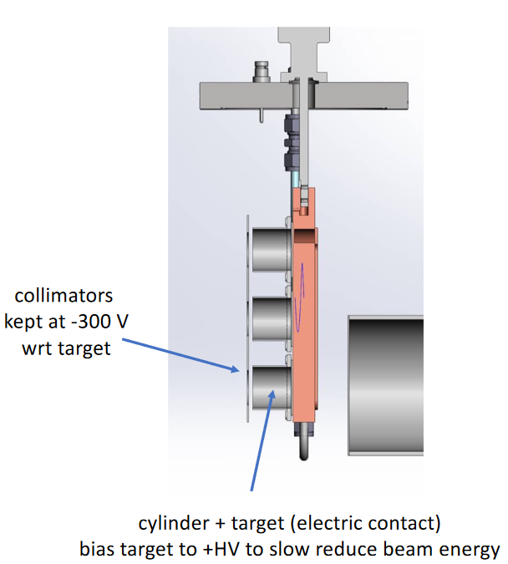
Experimental method
Instead of changing the proton beam parameters a bias in small increments is applied to scan through the resonance range. The target selection and biasing is designed to allow remote access.
Initiate the beam with nominal energy
Bias the target and collimator by 300V
Beam on target to collect a spectrum with a NaI detector
Save and reset spectrum followed by a next bias step

Slide 6
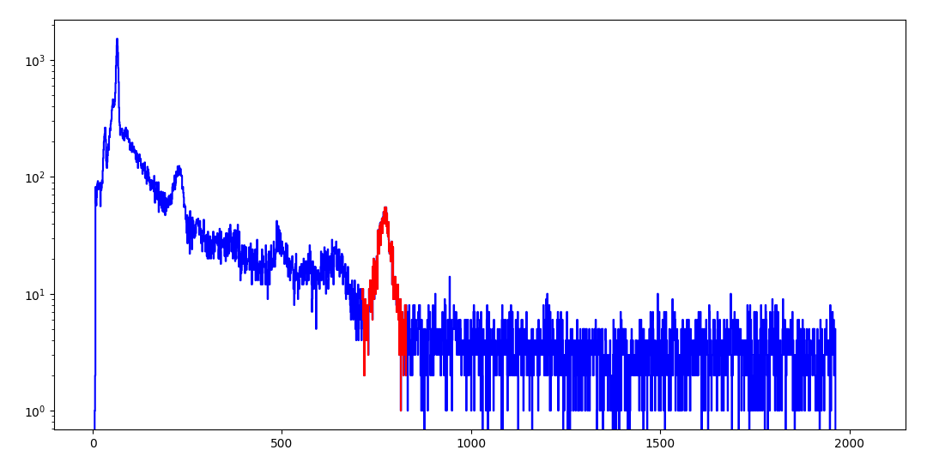
Data fitting
From the 27Al(p, γ)28Si reaction we expect gamma emission of about 1.78MeV so an appropriate region of interest has been selected.
A Gaussian and a first-degree polynomial is fit to the peak and the area obtained to be used in the yield calculation .

Slide 7
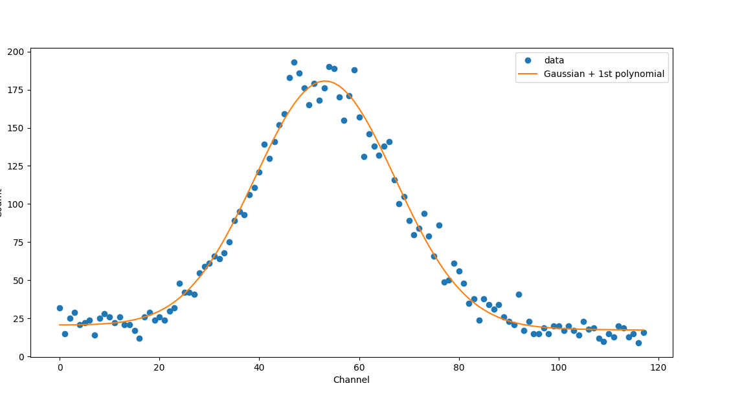
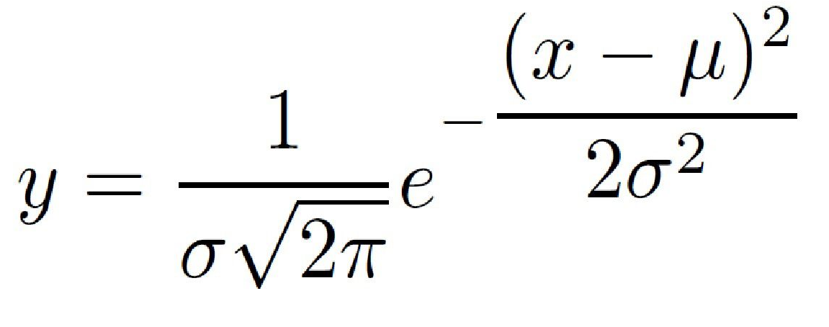
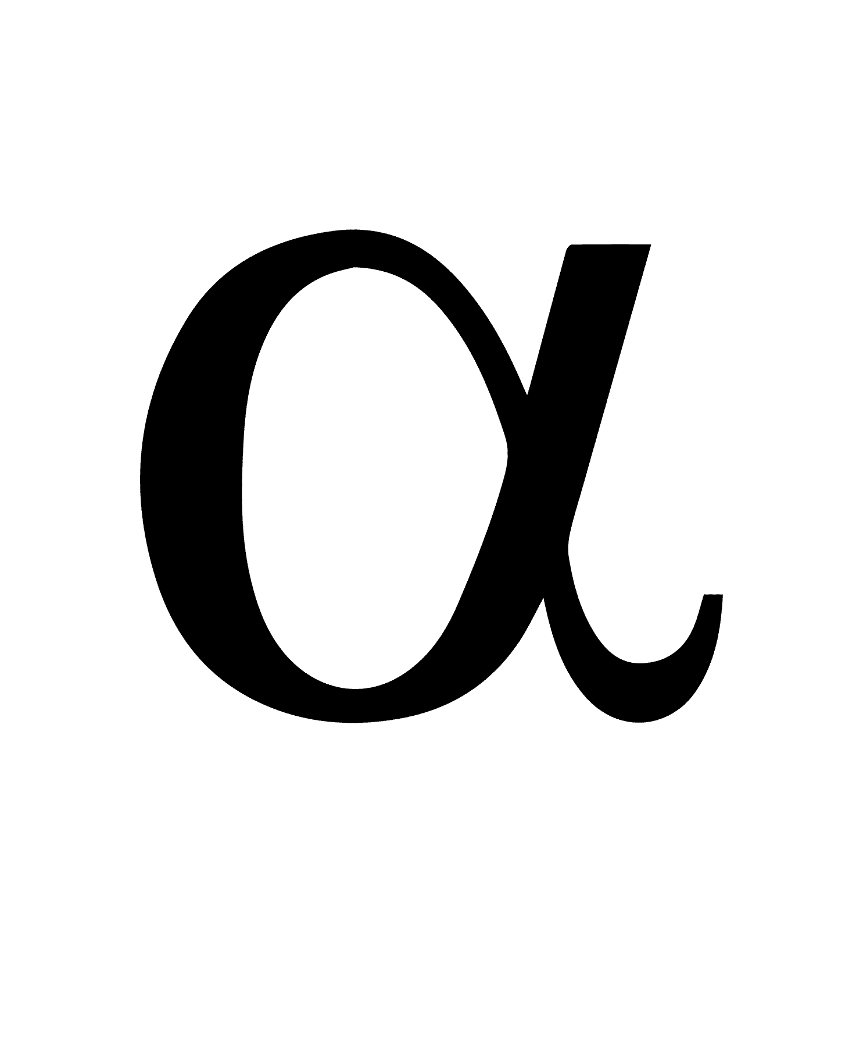

+

Slide 8
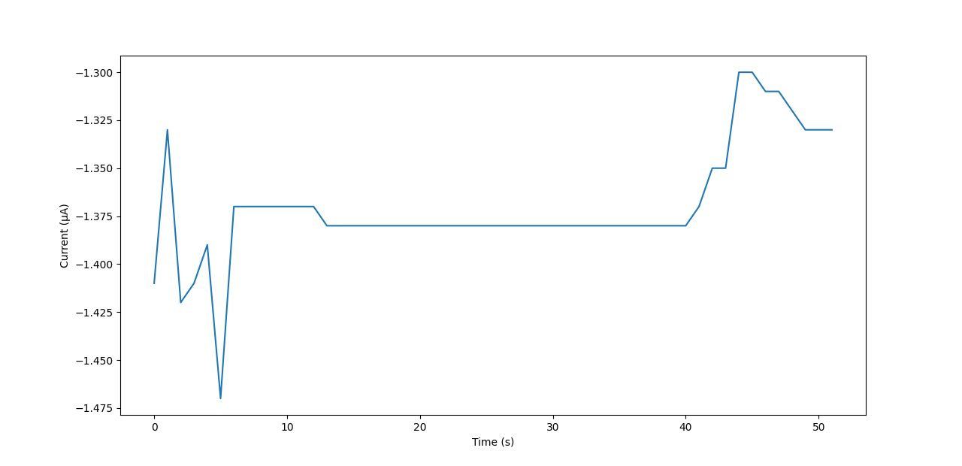
Data analysis
The spectra are saved with the use of Ortec MAESTRO in an ascii format to allow to extract raw data and preform the analysis.
Necessary parameters such us target voltage, current, time etc. are saved in real time to later be used to produce yield calculations.
Due unstable readings the current has been integrated using cumulative Simpson rule to obtain the total charge.

Slide 9
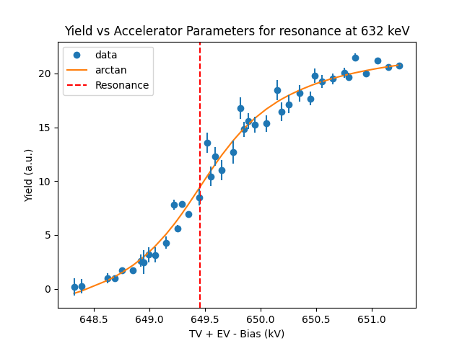

Resonance 632keV
For the resonance accelerator parameters correspond to 649.4543 kV

Slide 10
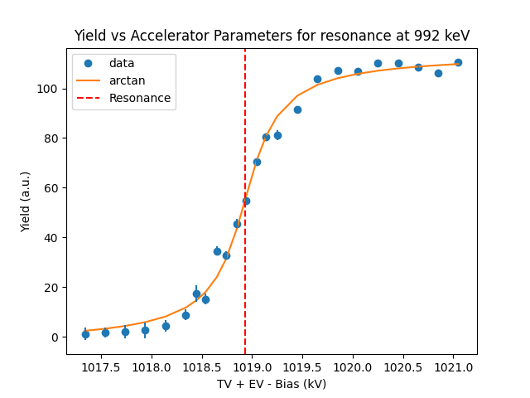
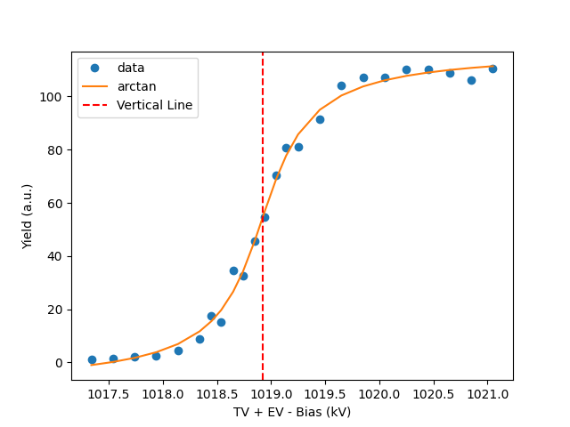
Resonance 992keV
For the resonance accelerator parameters correspond to 1018.91981 kV

Slide 11
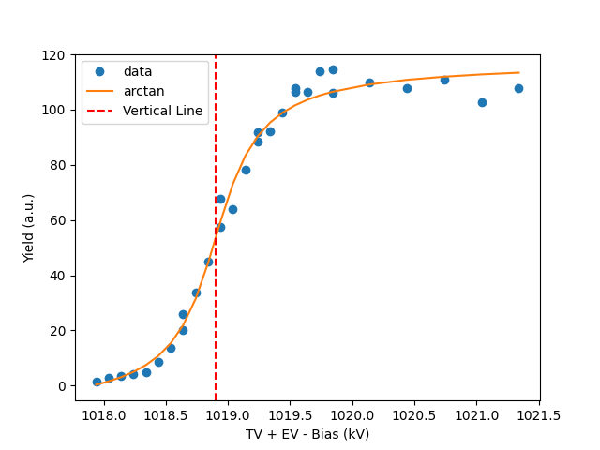
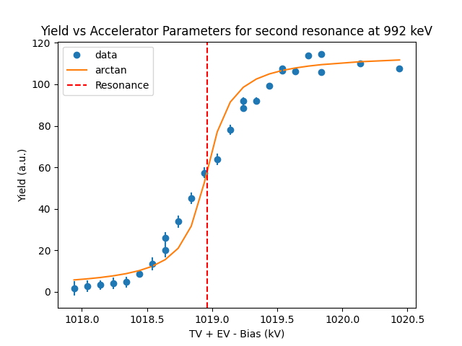
Resonance 992keV second measurement
For the resonance accelerator parameters correspond to 1018.90095 kV

Slide 12
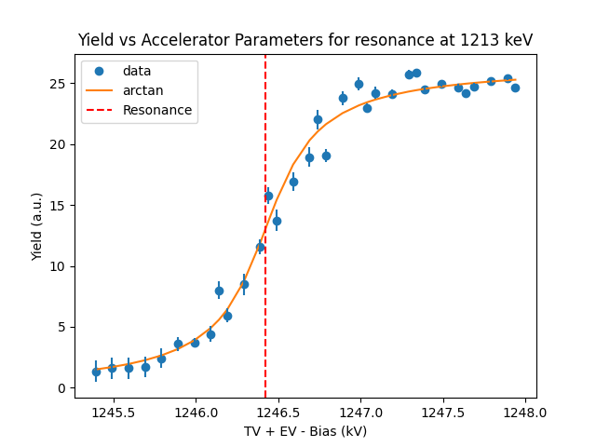
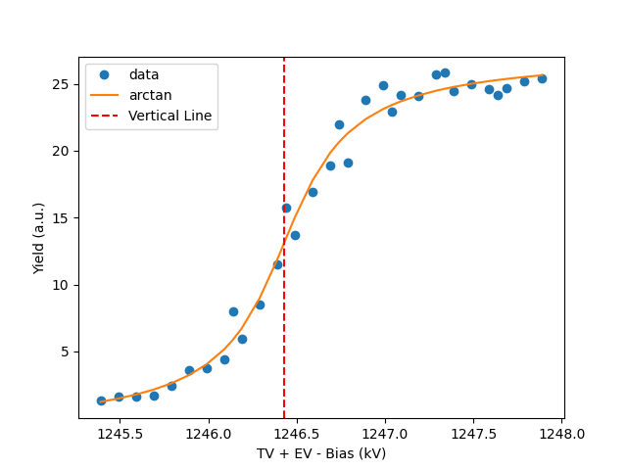
Resonance 1213keV
For the resonance accelerator parameters correspond to 1246.42904 kV

Slide 13
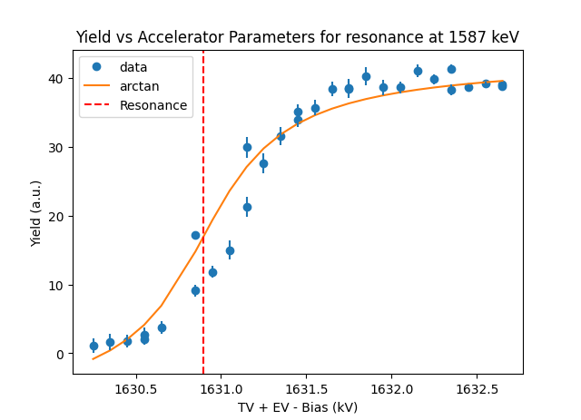
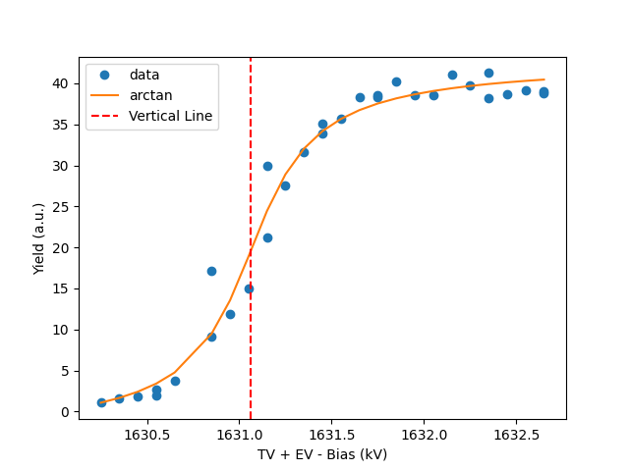
Resonance 1587keV
For the resonance accelerator parameters correspond to 1631.06402 kV

Slide 14
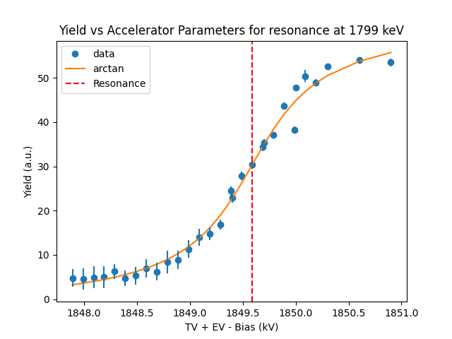
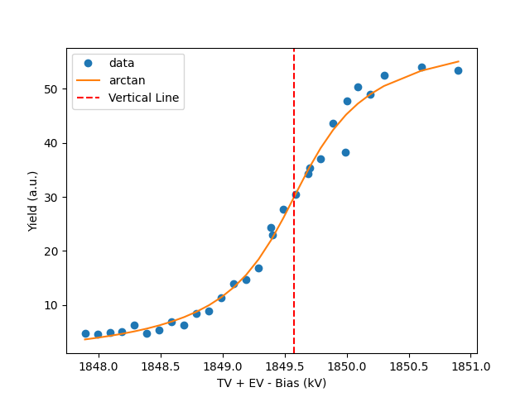
Resonance 1799keV
For the resonance accelerator parameters correspond to 1849.57656 kV

Slide 15
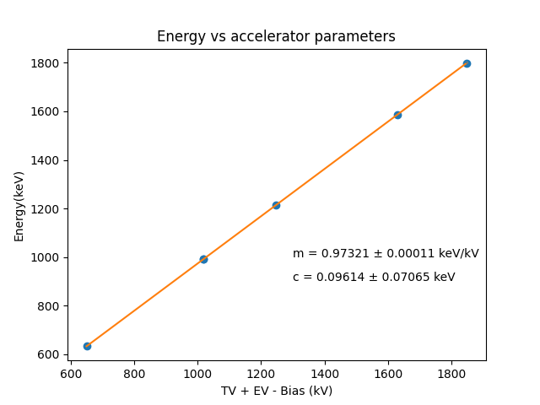
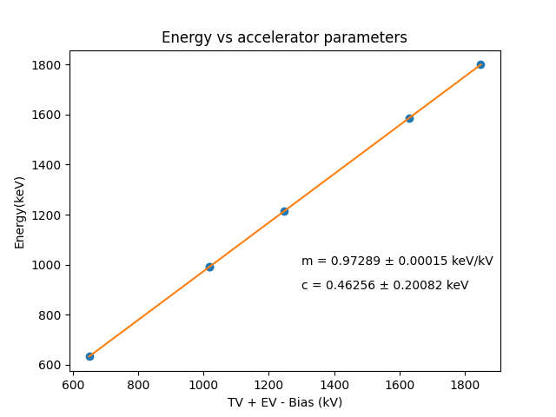
Accelerator parameters

Slide 16
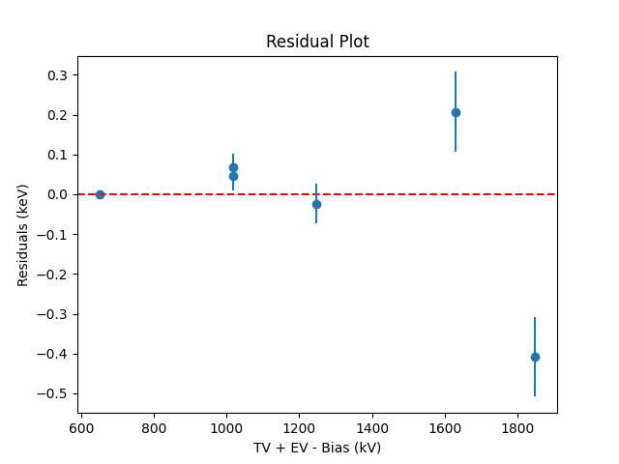
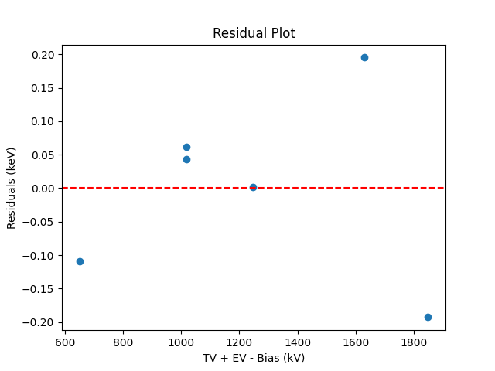
Residuals

